Slide 1
System for Open-Water Person Detection
By
Justin Toth
Advisor: Professor Douglas A. Lyon, Ph.D.
A Thesis submitted to the Graduate Faculty of Fairfield University in partial fulfillment of the requirements for the degree of A Master of Science in the Electrical and Computer Engineering program.
Notes:
-Good afternoon my name is Justin Toth, I am a graduate student here at Fairfield university pursuing a masters degree in electrical and computer engineering.
-Today I will be presenting my masters thesis System for open-water person detection. Which is the development and design of a method of sensor fusion utilizing multiple infrared sensors connected through a mesh network for aerial drone search and rescue operations

Slide 2
Overview
Introduction
System Design
Testing
Conclusions
Notes:
-Presentation is broken into four sections
-Introduction where we will review the problem statement, current market and what our contribution will be
-We will go over how the system was designed and what choices went into our component selection
-Our system was evaluated through experimental testing. Which we will discuss our testing setup and results
-Finally we will bring together all the observations, results, draw conclusions and give perspectives on the future works in this area.

Slide 3
Introduction
Notes:
-But first, the introduction

Slide 4
Problem Statement
In order to locate a person requiring rescue we seek to design and implement a system that makes use of mesh networking with multiple unmanned aerial vehicles equipped with image sensors to locate the person.
Notes:
Read slide.
In order to locate a person requiring rescue we seek to design and implement a system that makes use of mesh networking with multiple unmanned aerial vehicles equipped with image sensors to locate the person.

Slide 5
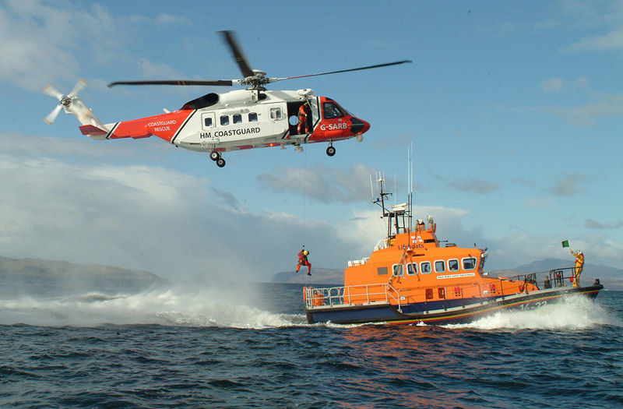
Addressable Market
Bristow Group
Private company performs SAR for the UK
Utilizes S-92 Helicopters
$27M each & $900k per year upkeep
107 Counties with coastlines >350km
74 of those have military aircraft
$2 billion in assets
$66.6 million per year in upkeep
Notes:
-Currently search and rescue missions are performed by expensive manned vehicles, such as the S-92 shown here.
-Looking to replace or augment search and rescue helicopters with a multiple drone system
-Typically these searches are performed by governments but in some cases such as the Bristow Group they are performed by a private company.
-From the world fact book, there are 74 counties with similar military aircraft and a significant coast line.
-Assuming even 1 aircraft of equivalent cost for search and rescue in each of these counties that is….2 billion in assets and 66.6 million in recurring upkeep costs per year

Slide 6
Contribution
To the field of sensor fusion
Method of image processing of data from IR sensors and communicating results over a mesh network in order to locate people at a reduced cost compared to current methods.
Notes:
-taking advantage of low cost and low complexity commercially available sensors
Method of image processing of data from IR sensors and communicating results over a mesh network in order to locate people at a reduced cost compared to current methods.

Slide 7
System Design

Slide 8
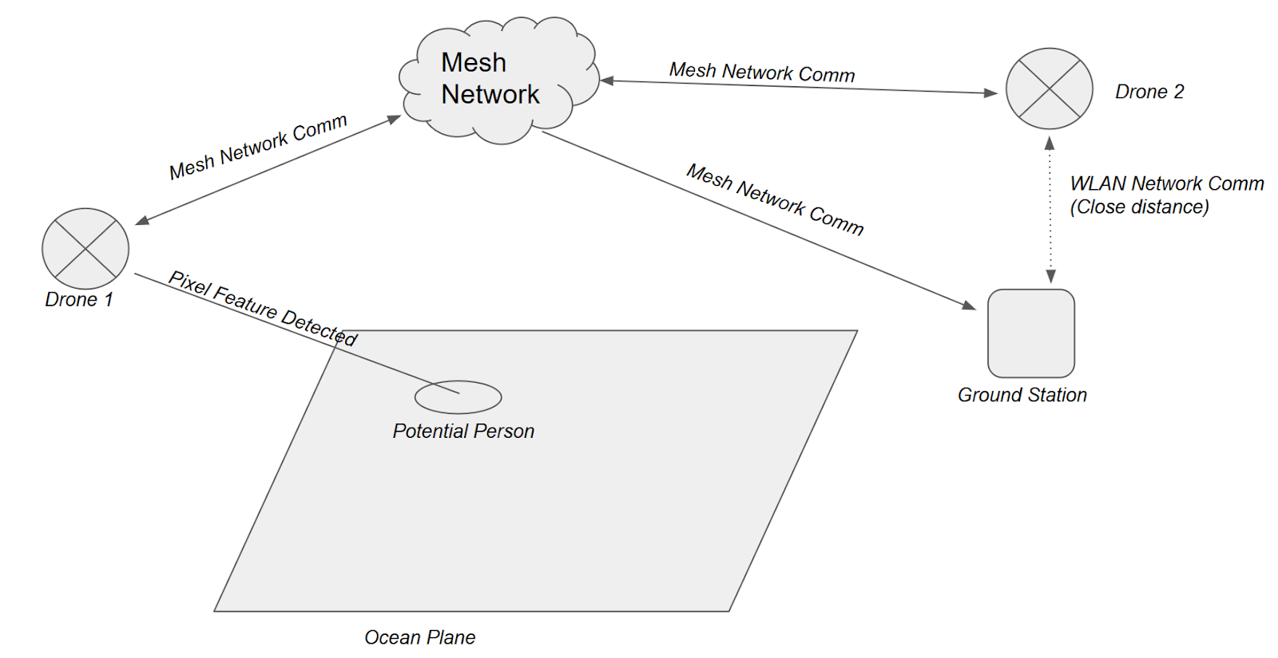
System Architecture
Notes:
-System will consist of multiple drones, 2 shown in diagram
-optional ground station
-ground station and each drone will be a node in the mesh network.
-drones will search an open area such as an ocean for people using infrared sensors. Any potential people detected will be communicated with the rest of the network
-ground station can connect to an individual drone over a LAN to access onboard image and log storage and also access software interfaces with live video feeds.

Slide 9
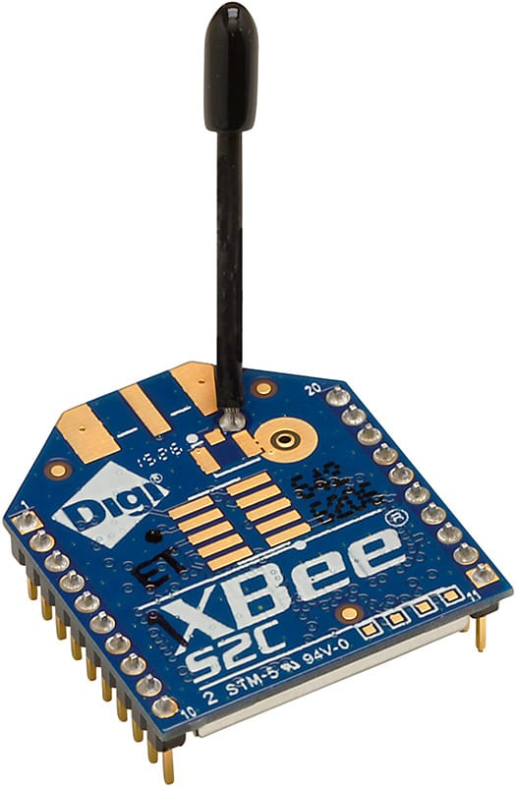
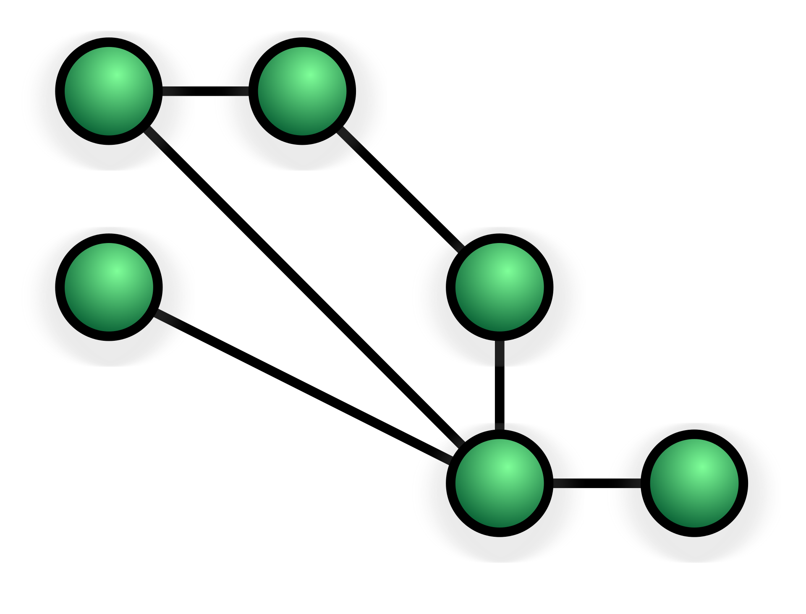
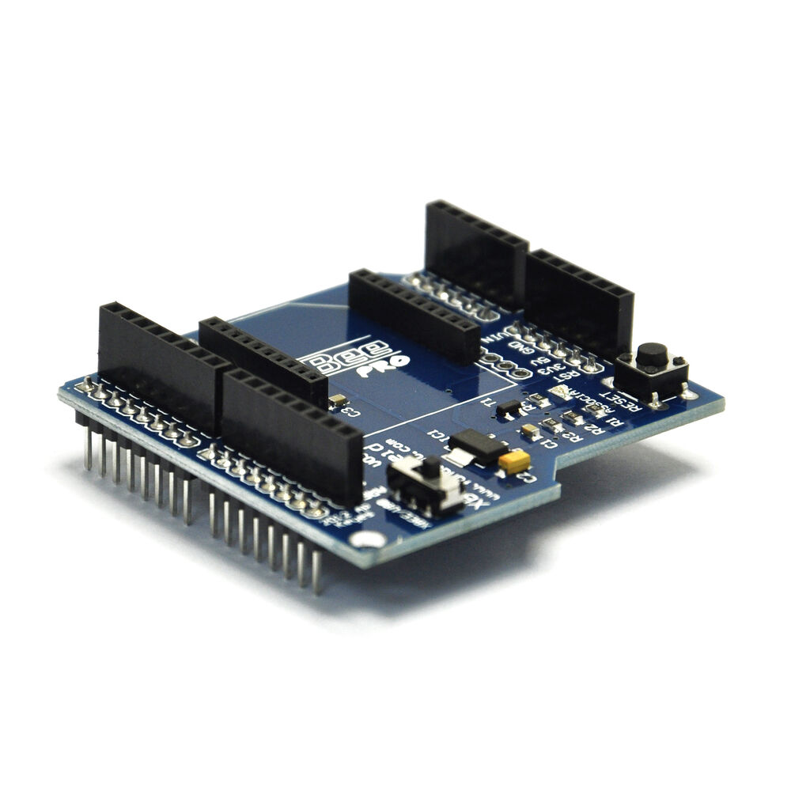
Mesh Network
Mesh Network
Non-hierarchical
Adaptable
XBee Zigbee Adapter
Digikey kit
Range 2 miles LOS
Node
Network Connection
Mesh Network Diagram
Notes:
For my system, I selected to use a mesh network.
Mesh network is a network topology which consists of nodes. These nodes connect to as many other nodes in range as possible to pass along data and create a network.
Why a mesh network?
Mesh networks offer the pros of:
Non-hierarchical – no main hub
Adaptable which is important when operating in areas where you may lose drones or signals due to weather.
Each device will be equipped with a network adapter
Specifically choose the Xbee zigbee from digikey which offered a mesh network kit easily adaptable to the raspberry pi.

Slide 10
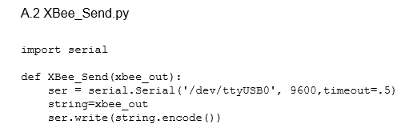
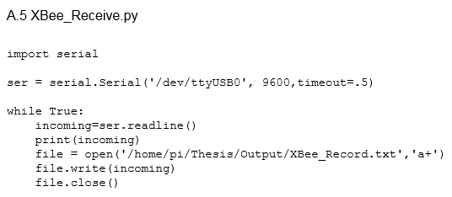
Mesh Network Software
Notes:
Software for the digikey kit was straight forward for the raspberry pi utilizing the standard serial library available in rasbian

Slide 11
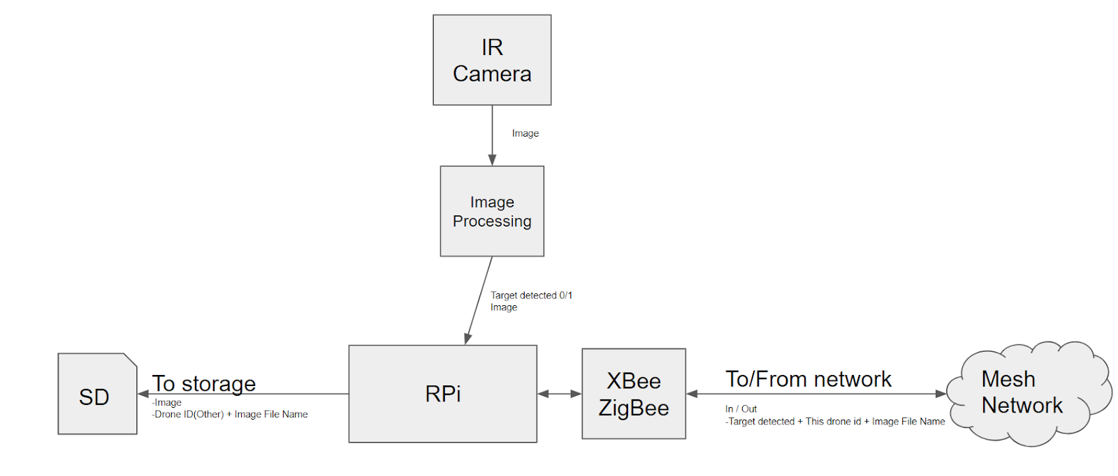
Image Capturing Device (Drone)
Notes:
The first and primary node of the system is the image capturing device. A full implementation of this system is expected to have multiple of these devices and it is expandable.
Above is the diagram of the image capturing device
Each device will be run by a raspberry pi, a MarkerFocus Raspberry Pi Battery Pack, contain an infrared camera, onboard storage (part of Rpi) and a Xbee adapter.
Battery pack has an estimated run time of 3.8 hours based on 3rd party benchmarking.
Images from the IR camera will be captured and processed in search of people at regular intervals.
If an object is detected it will be saved to storage and as it will communicate the detection to other
Additionally it will monitor the network for any other devices which detect objects and log that data locally. All network nodes will have a full list of all objects detected and by which node (by serial number) and have images stored of objects that node detected.

Slide 12
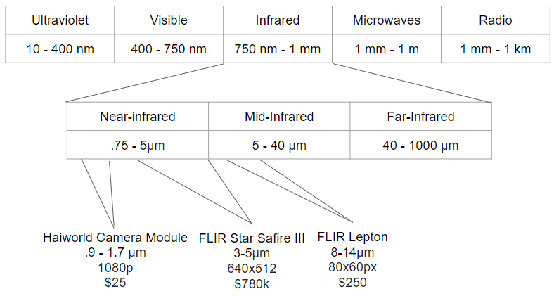

Near- vs Mid-Infrared
FLIR Lepton (Person at ~30’)
Notes:
For selection of our infrared camera some research was done into available cameras and spectrums.
The infrared spectrum is fairly large, spanning from the edge of visible light to microwave frequencies. However, not all the frequencies in this range are related to heat.
Typical cheap “night vision” cameras such as the haiworld camera shown on the left operate at near-infrared these frequencies are not associated with heat.
-cameras operate similar to visual light. [elaborate on similarities]
-[elaborate on cons] [dangers of illumination in IR]
-the longer wavelengths in the near infrared spectrum and the mid-infrared spectrum are the frequencies associated with heat.
-[explain picture] picture from the FLIR lepton, Haiworld at same range was completely black.
-the FLIR star safire III is a common infrared camera used in search and rescue operations today. The range is closer to that of the FLIR lepton, but its cost and resolution are much higher.

Slide 13
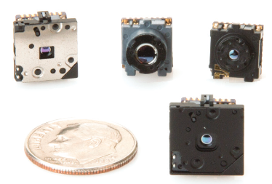
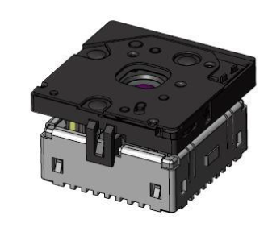

Infrared Camera
FLIR Lepton long-wave Infrared Camera
80x60 Resolution
Notes:
After research and testing it was concluded that even with the low resolution of the FLIR lepton was the most appropriate camera.

Slide 14
Infrared Camera - Software
Stored Baseline
80x60 array of pixel values 0-255
Result:
Notes:
-Explain baseline scene N = 90% of N-1 + 10% captured
- Delta >20 value which is ~+-11.75C

Slide 15
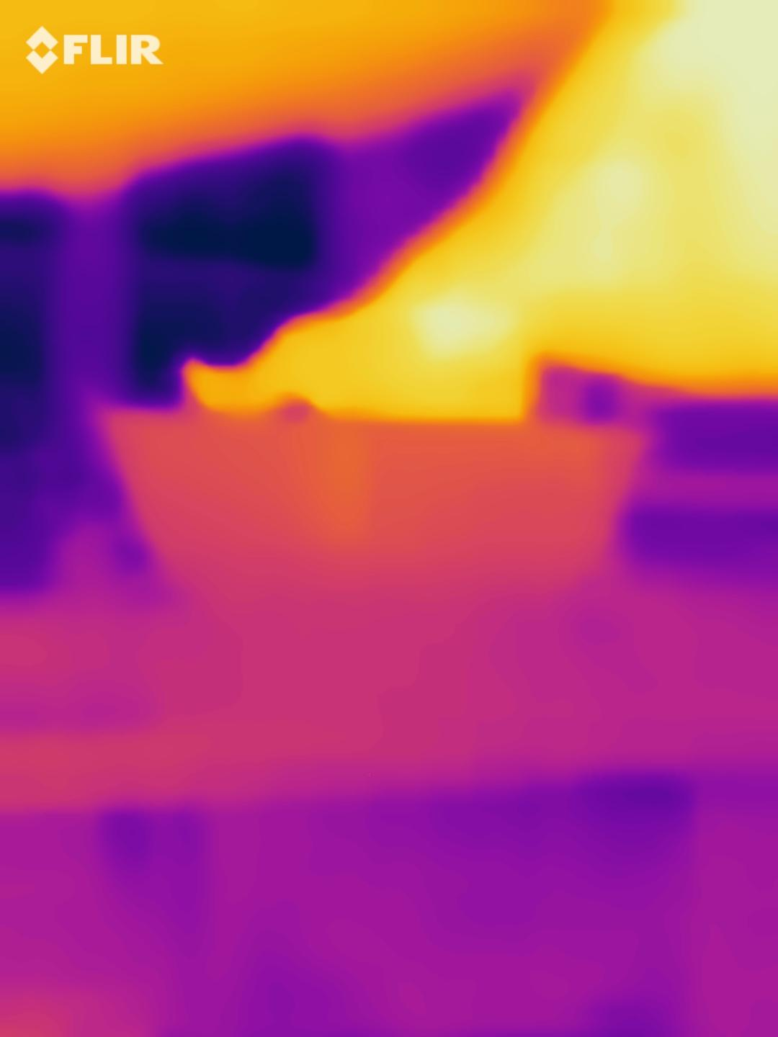
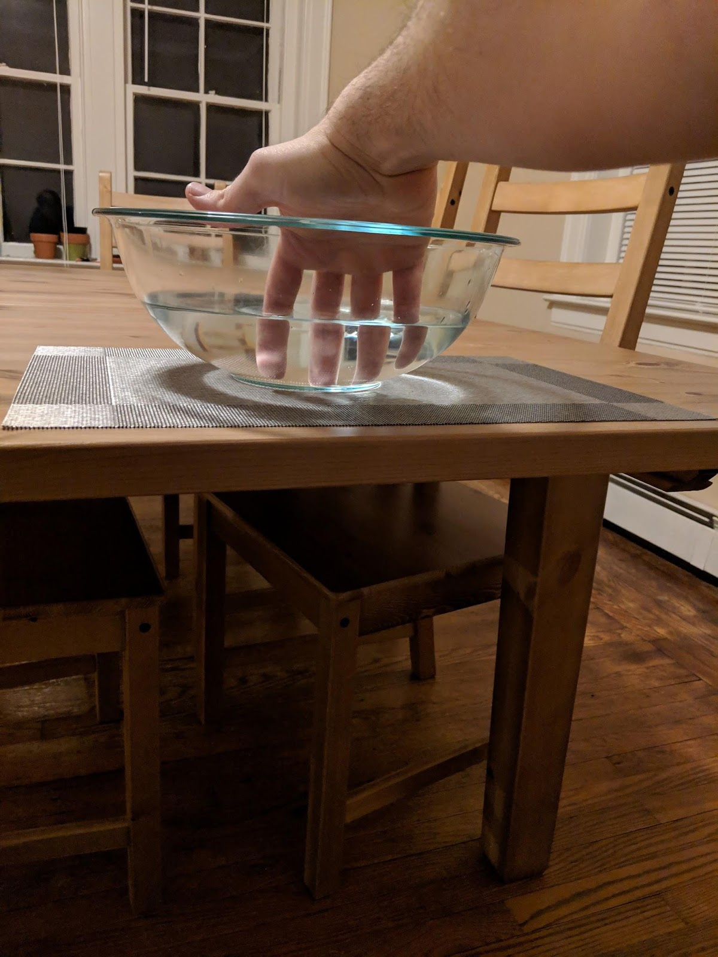
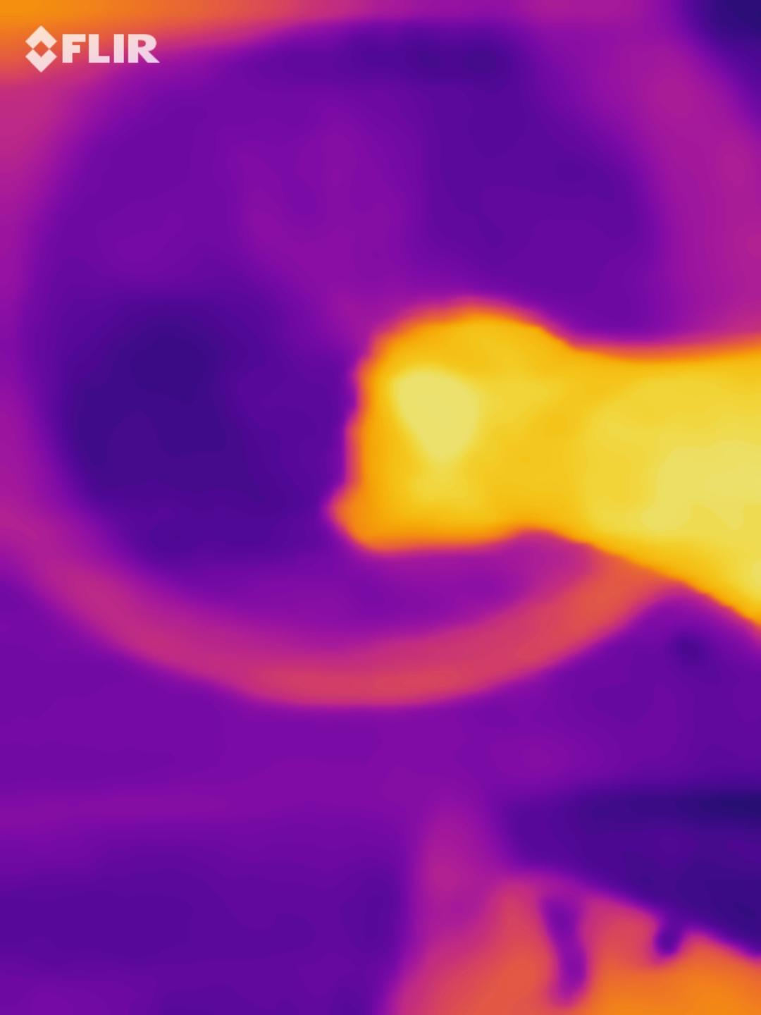
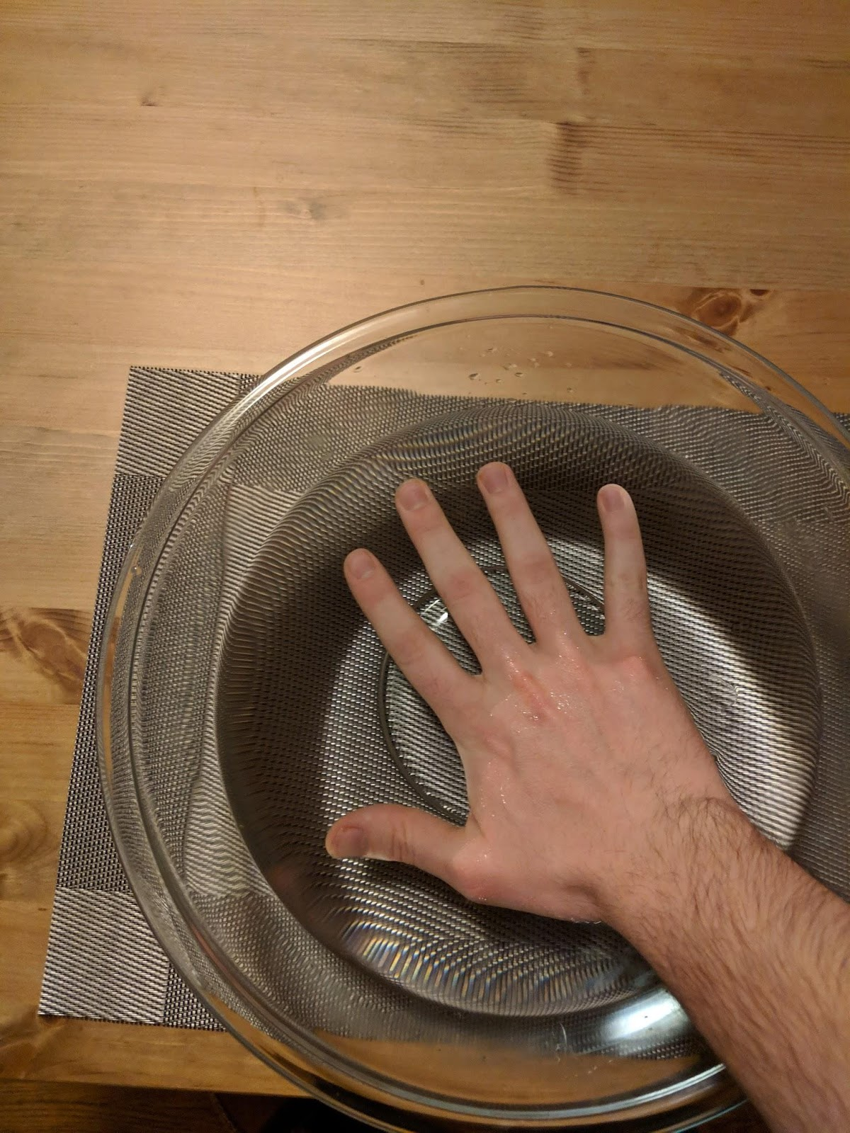
Issues with Infrared Imaging
Notes:
While performing tests some characteristics of infrared were observed.
Images above captured with the FLIR One product with higher resolution newer FLIR Lepton chip
-Glass [make notes to lenses]
-Water [ make notes of dampness]

Slide 16
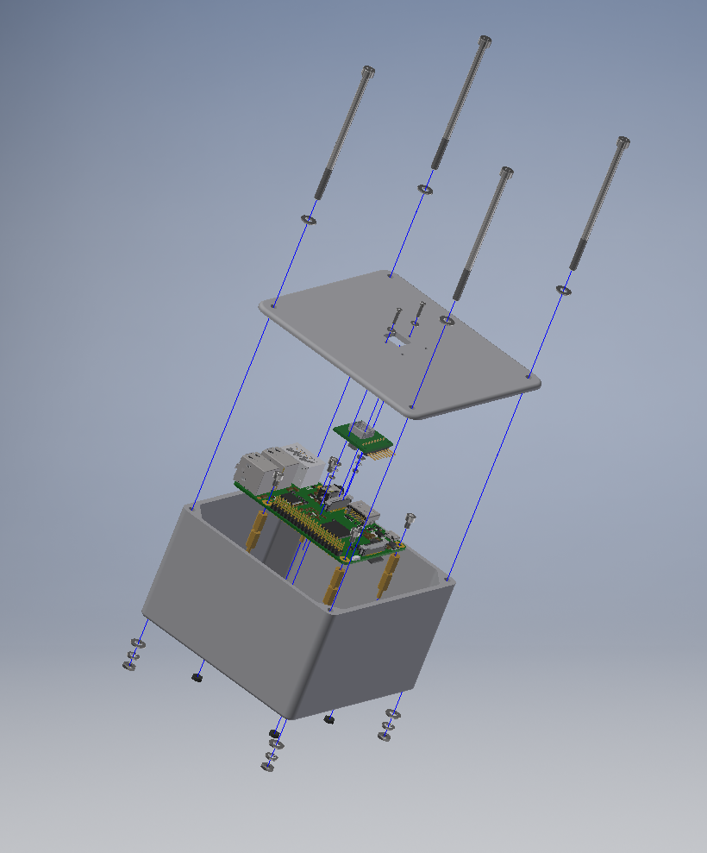
Enclosure
Notes:
For prototyping I chose a 3D printed enclosure
[have physical example on hand]

Slide 17
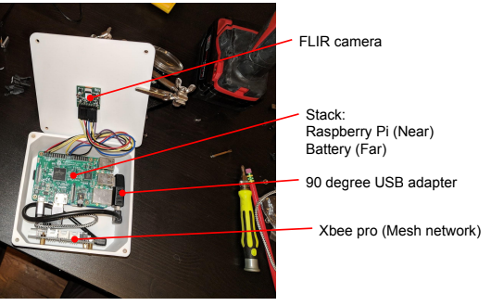
Image Capturing Device
Notes:
90 degree adapters and cables to contort to space
-Cons
--redundancies of components
--inefficient space
--Future improvements single PCB

Slide 18
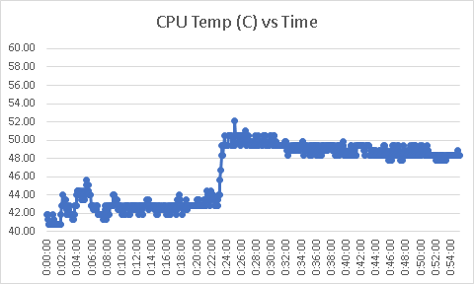
Enclosure – Thermal Test
Total of 55 min test on battery power
24 min with just OS (Stable @ 43C)
30 min with image process (Stable @50C)
Ambient air temperature @ 21C
Time of day: Night
2000 images captured processed and stored.
Notes:
-With lack of data on thermal properties of devices and enclosure a test was performed for the viability of current enclosure design.
-Note spike when processing was turned on
-Conclusion: no additional thermal mitigation plan needed for this enclosure.

Slide 19
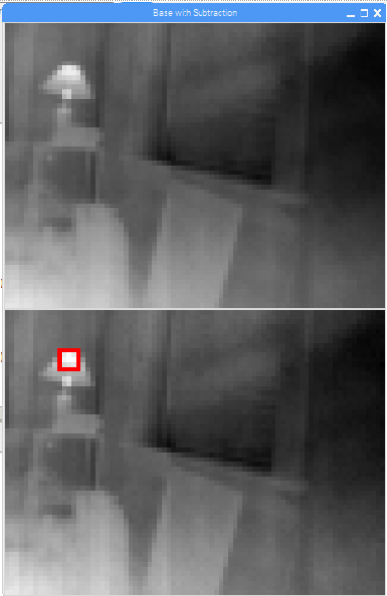
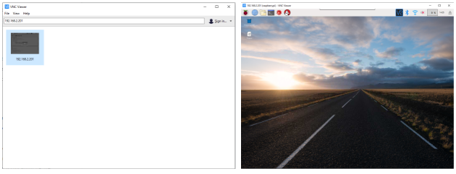
Ground Station
Windows OS Computer on same LAN as RPi
Access RPi software UI’s
Access RPi storage
Notes:
Ground station used to access the raspberry pi of image capturing device when there are no peripherals attached and contained in the enclosure.
VNC Viewer, must be on same LAN
Live FLIR video feed
Other software UI’s such as the image shown.

Slide 20

Cost
Raspberry Pi | $36.95
FLIR - Lepton Chip | $259.00
FLIR - Lepton Board | $39.99
XBee Zigbee Pro Chip | $39.45
XBee Zigbee Board | $13.99
Battery | $14.99
Enclosure | $179.15
Misc Parts (Wire, fasteners) | $20.00
Image Capturing Device Total | $603.52
$75,000 single month upkeep
Vs
Image Capturing Device ($603 * 35) | $21,123.20
Drones ($1,500 * 35) | $52,500
Ground Station ($800) | $800
35 Device System | $74,423.20
Notes:
Breakdown of a single image capturing device parts list and cost on the left
Theoretical system replacement of 35 image capturing device system for less than the cost of monthly upkeep on an S-92

Slide 21
Testing

Slide 22
Evaluation Requirements
Determine detection success rate.
Determine system response time.
Store all images and review after test
Scene contains a sparse distribution of people
Instances of people in scene should be monitored for system pass/fail
Review images captured prior to target detection for response time.

Slide 23
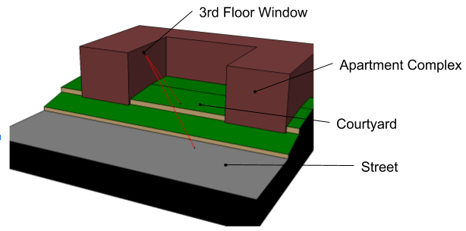
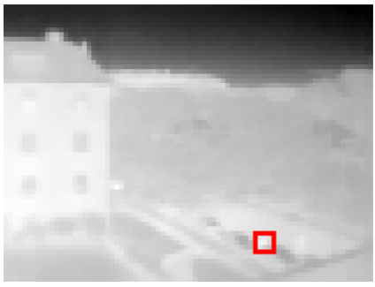
Test Setup
Image capturing device in 3rd floor window
Courtyard: ~60’
Street: ~115’
Notes:
Image on left is a model of the experiment scene
Prototype placed in 3rd floor window
Courtyard below at approx. 60 feet
Street is at approx. 115 feet
Image on right is the view from the image capturing device

Slide 24
Test
Duration: 30 min
1,800 captured and processed images
Five controlled events of people walking into the scene
Notes:
Test lasted for 30 min running on battery power and connected to the ground station
Explain controlled events

Slide 25
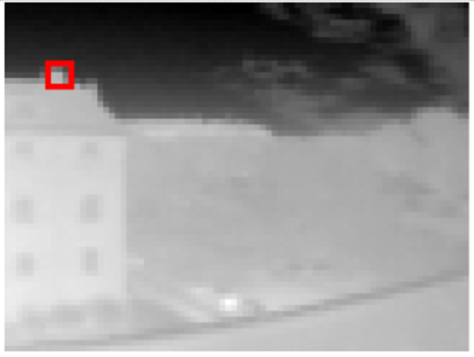
Test Results
100% of controlled events were detected
4 of 5 detected first available frame
1 of 5 detected on second frame
Resulting detection time of .7 seconds
21 of 140 (15%) flagged images were erroneous
Notes:
Second frame detection was due to partial object in frame.
Detection time assumed uniform distribution over time of objects entering the frame
Erroneous flags were from chimney as shown on right and passing cars exhaust.
Detection time math: uniform distribution of objects into frame. At 1 frame per second assumes objects are in the scene on average of .5 sections until an image is taken. So 4 single frames and 1 double frame averages to .7 seconds.

Slide 26
Conclusions
Mid-infrared spectrum is excellent for detecting people at medium ranges (<100’)
Greatly reduced costs compared to existing systems being used
Low resolution hinders using them at distances >100’
Future works need to improve range detection or reduce system range to target.
Notes:
-In controlled conditions the system was able to detect people with acceptable success rates during experimentation.
-big cost savings when compared to manned helicopters
-Aircraft typically fly higher than 100’.
-@100’ horizontal path sweep is 86’
-commercially available infrared friendly lenses
-novel fleet / flying pattern

Slide 27
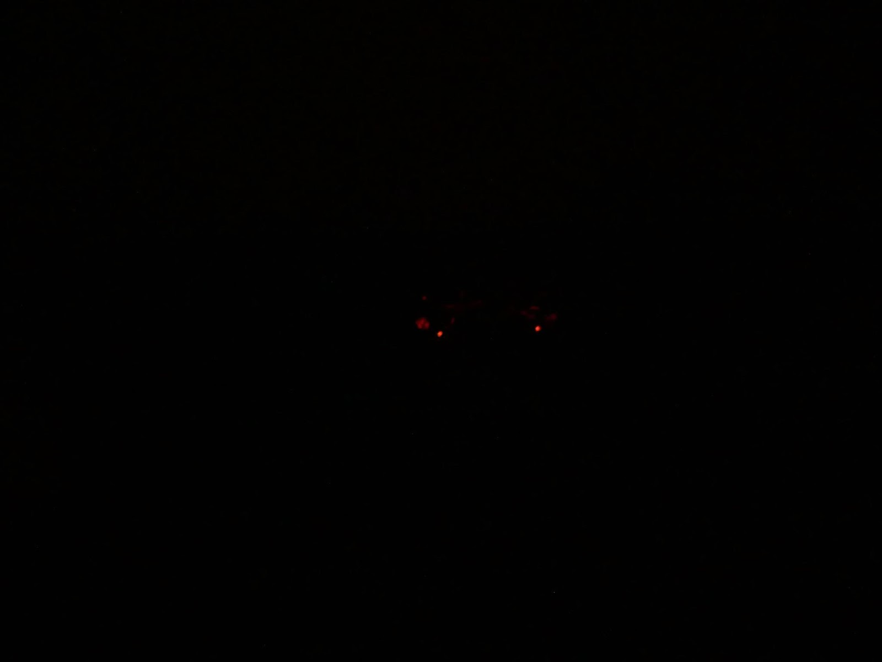
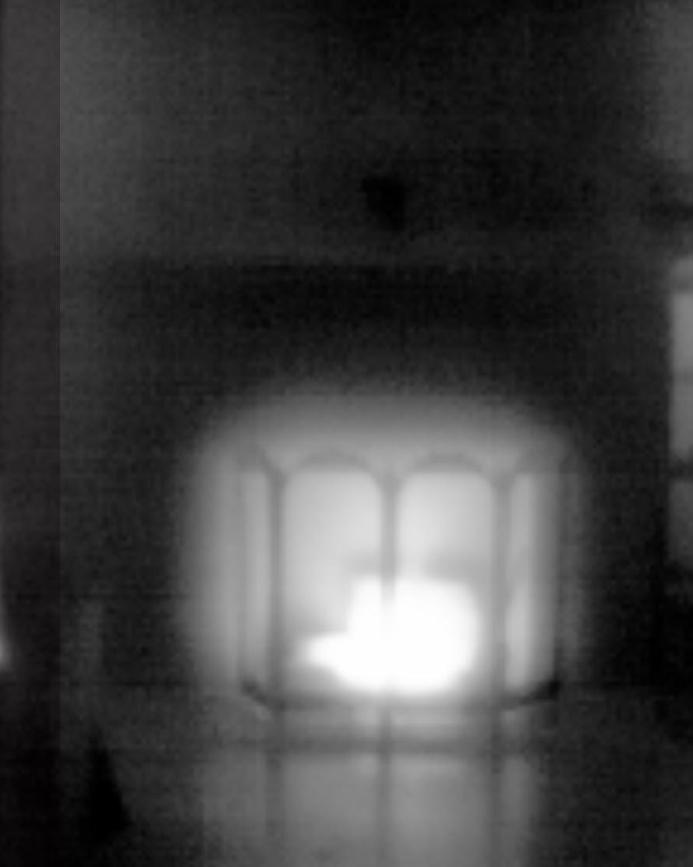
Future Works
PCB Boards
Lenses
GPS Sensor Fusion
Other applications such as firefighting operations
Notes:
-reduce profile and weight while eliminating redundant components
-availability of low cost infrared friendly lenses
-GPS sensor fusions, note works of C B Chatterji and aiding aircraft landing from cameras and known light patterns
-Fire fighting! Wild fire edge detection. Embers and new fires

Slide 28
Questions?
Notes:
-answer any questions

Slide 29
Backup slides

Slide 30
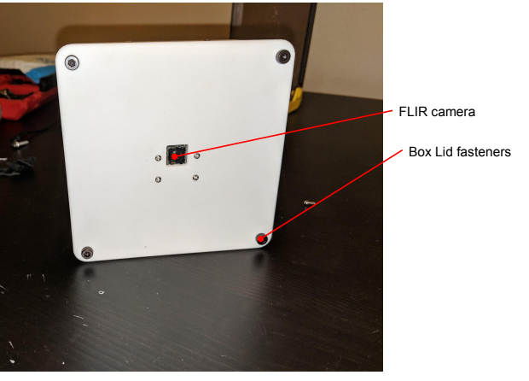

Slide 31
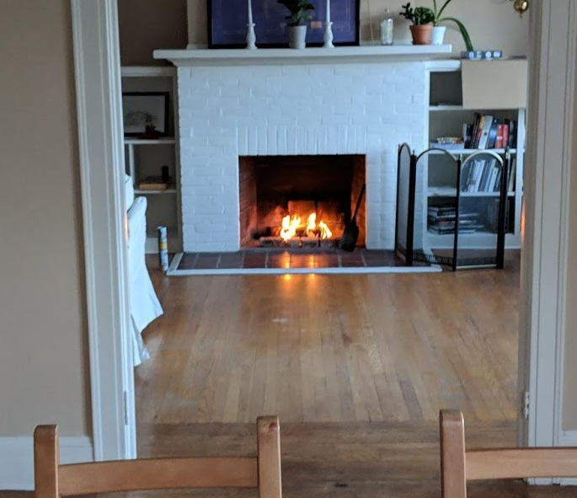
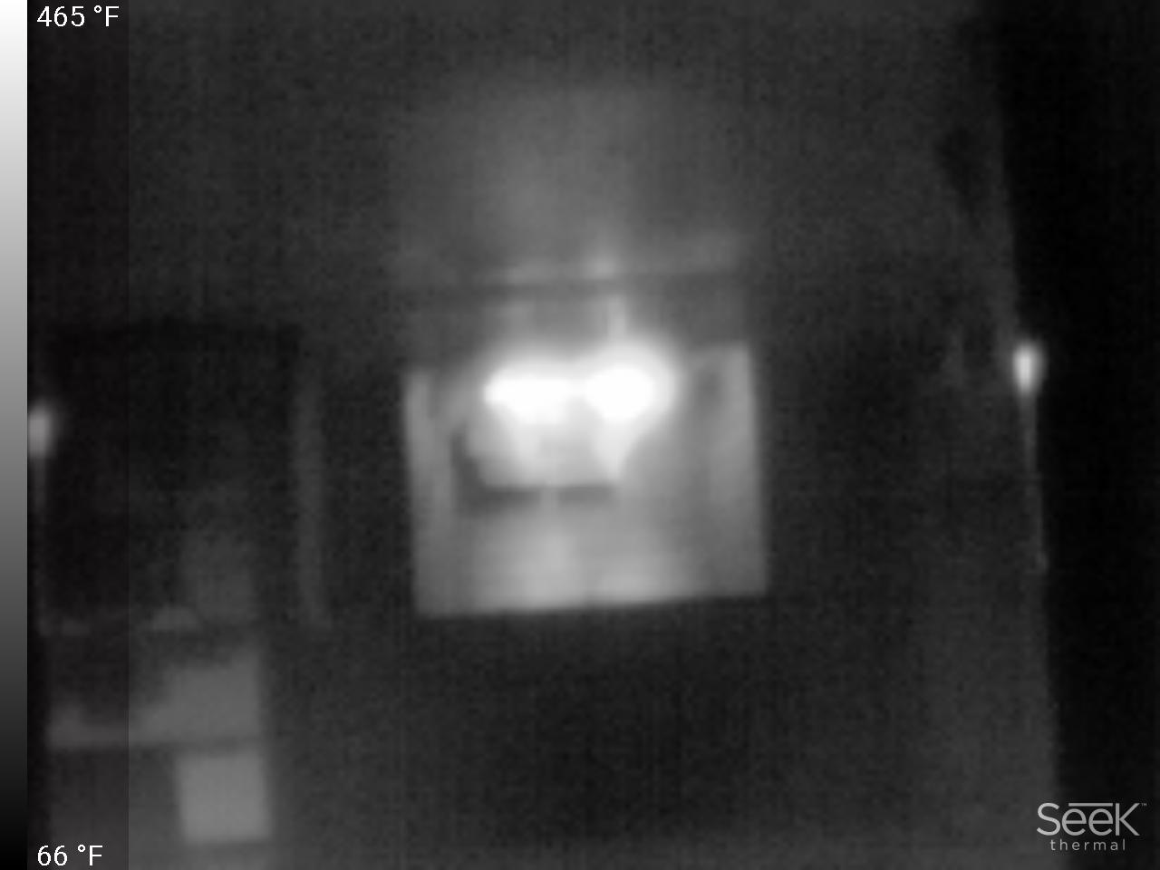
Notes:
Fire….

Slide 32
Notes:
Embers of a fire that has died down, but still has considerable IR radiation

Slide 33
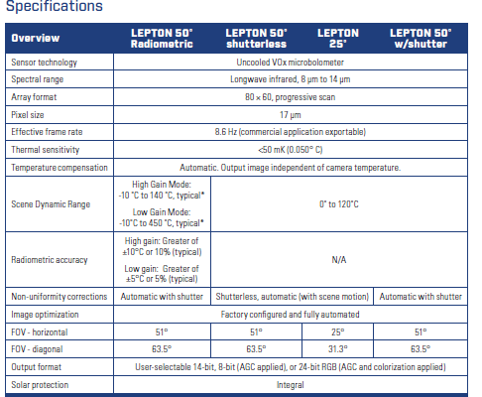
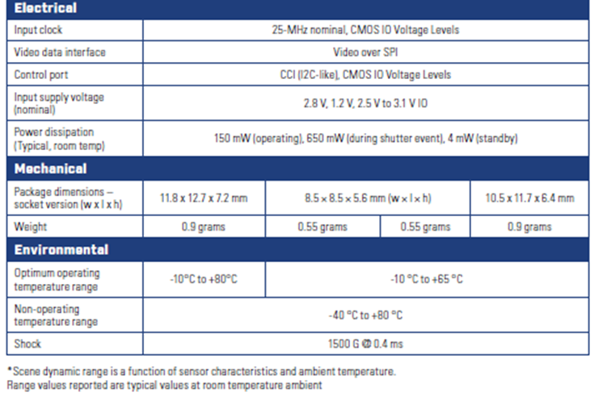
Notes:
FLIR Lepton Specsheet

Slide 34

Replace with spec sheet
Notes:
Power source

Slide 35
